Slide 1
GUI BASED FILE EXPLORER
PRESENTED BY AMMAR ZEESHAN

Slide 2

Problem Analysis and Solution Breakdown
Problem ANALYSIS
Solution IDEA
System Objectives

Slide 3

Key Challenges
Gui Application
Gui Handling
Code Quality And Modular Design

Slide 4

Techniques Applied
Recursion
Tree Data Structure
Depth-First Search (DFS)
os module (file/folder access)
shutil module (move/delete operations)
tkinter (GUI development)
PIL module (images display e.g file icons)
OOP (Classes for nodes and GUI logic)
Exception Handling (try-except)

Slide 5



Conclusion
Achievements
Future Improvements
DSA in Real-World Problem Solving

Slide 6
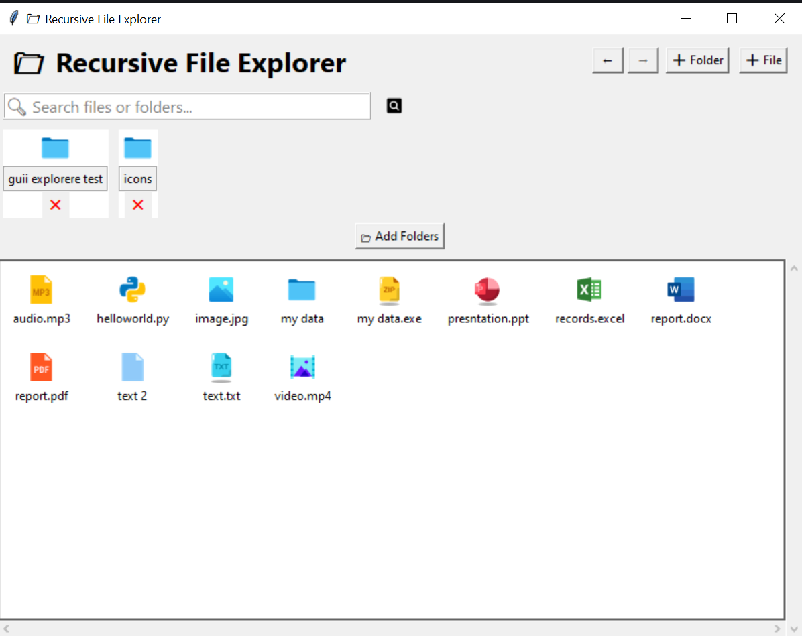
SAMPLE OUTPUT

Slide 7
Thank you very much!

